Slide 1
Streaming - Lambda Architecture
Sep 2019

Slide 2
Agenda
Standard Lambda Architecture
Delta Lake Architecture
Case Studies

Slide 3
Standard Lambda Architecture

Slide 4
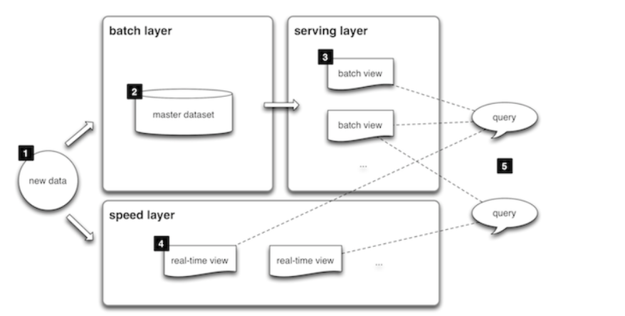
Conceptual Lambda Architecture
Lambda architecture is a way of processing massive quantities of data (i.e. “Big Data”) that provides access to batch-processing and stream-processing methods with a hybrid approach.
The lambda architecture itself is composed of 3 layers:

Slide 5
Conceptual Lambda Architecture contd..
Batch layer:
New data comes continuously, as a feed to the data system. It gets fed to the batch layer and the speed layer simultaneously. The batch layer has two very important functions:
a. To manage the master dataset
b. To pre-compute the batch views.
Serving layer:
The outputs from the batch layer in the form of batch views and those coming from the speed layer in the form of near real-time views get forwarded to the serving. This layer indexes the batch views so that they can be queried in low-latency on an ad-hoc basis.
Speed Layer (Stream Layer):
This layer handles the data that are not already delivered in the batch view due to the latency of the batch layer. In addition, it only deals with recent data in order to provide a complete view of the data to the user by creating real-time views.
Any incoming query can be answered by merging results from batch views and real-time views.

Slide 6
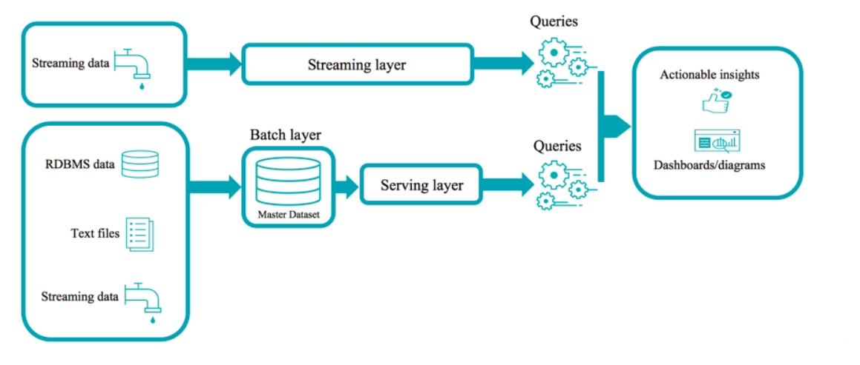
Lambda Reference Architecture
Lambda architecture features an append-only immutable data source that serves as system of record. Timestamped events are appended to existing events (nothing is overwritten). Data is implicitly ordered by time of arrival.

Slide 7
Delta lake Architecture

Slide 8
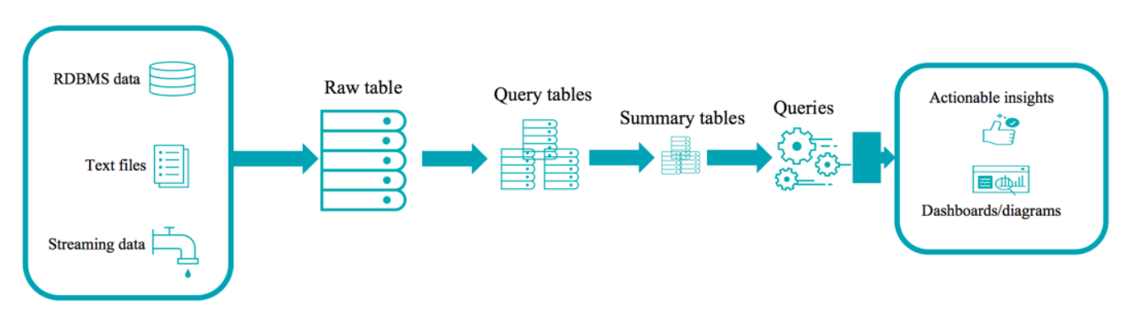
Databricks Delta Lake Architecture
The Delta Lake provides different design for handling Batch and stream processing
Text files, RDBMS data and streaming data is all collected into a raw table (also known as "bronze" tables at Databricks).

Slide 9
Databricks Delta Lake Architecture
A Raw table is then parsed into query tables (also known as "silver" tables at Databricks). They may be joined with dimension tables.
Summary tables (also known as "gold" tables at Databricks) are business level aggregates often used for reporting and dashboarding. This would include aggregations such as daily active website users.
The end outputs are actionable insights, dashboards and reports of business metrics.

Slide 10
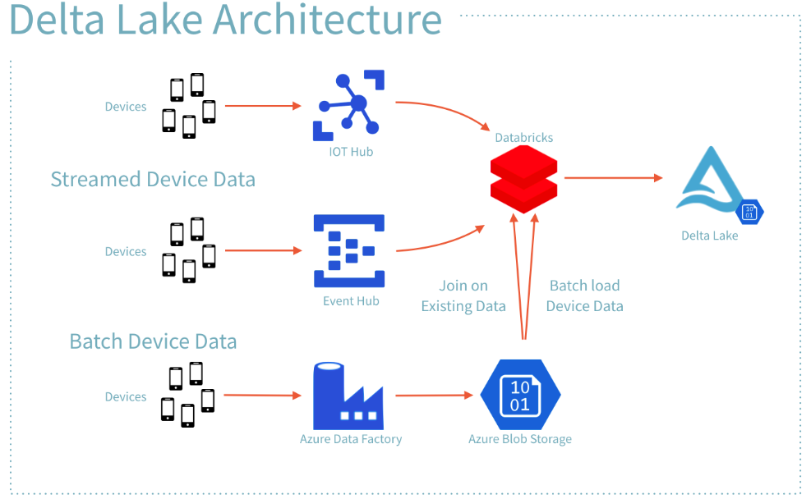
Databricks Delta Lake Architecture on Azure
An illustration of a Delta Lake Architecture is shown above.
Many devices generate data across different ingestion paths.
Streaming data can be ingested by IOT Hub or Event Hub
Batch data can be ingested by Azure Data Factory or Databricks
Extracted, Transformed data is loaded into a Delta Lake

Slide 11
Case Studies

Slide 12






Cyber Security
Business Drivers
Key Highlights
To build a platform on distributed streaming technology which is fault-tolerant, scalable and reliable and improving visibility to external threats, malfunctions and data vulnerability through Cyber Security and Analytics for Information security team.
Client was looking for pro-active cyber analytics instead of re-active.
Prevent insider threats resulting from unintentional bad/risked data accessed through Toyota Network.
Sprint based execution
Data acquisition from 50+ sources, 100gb of data per day, millions of evens per hour
Solution Highlights
Platform was built on distributed streaming technology which is fault-tolerant, scalable and reliable.
Re-usable streaming components are built.
Custom parsing framework with dynamic schema changes.
Extensible Lambda architecture
Automation of Big data cluster scale up and scale down in the Azure.
Automation of transient clusters to create/shutdown on required basis to save cost.
Real-Time Dashboards
Technology Stack: Cloudera Impala, Spark, Cloudera Director, Confluent Kafka, Azure and PowerBI / Tableau
Business Outcome
Centralized data lake in the cloud to collect all cyber information at one place.
Real-time analytics/dashboards for Infosec team to identify potential threats.
12

Slide 13










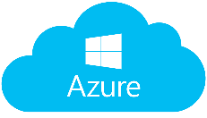





Cyber Analytics Big Data/Kafka Architecture
Data Sources
Data Types
On Premise Kafka
Structured Data
Producer
Producer
On Premise Brokers
RDBMS
Mainframe
Producer
Producer
Producer
Producer
Flat Files
XML Files
Message Queue
API
Semi Structured Data
Cloud
Social Media
Blogs /
Web Pages
Kafka Streams
Confluent replicator
Unstructured Data
Filebeat /
winlogbeats
Email
Kafka Splunk Consumer
Azure Brokers
Multimedia
Spark Streaming
Device / Machine Data
Control Centre

